Slide 1
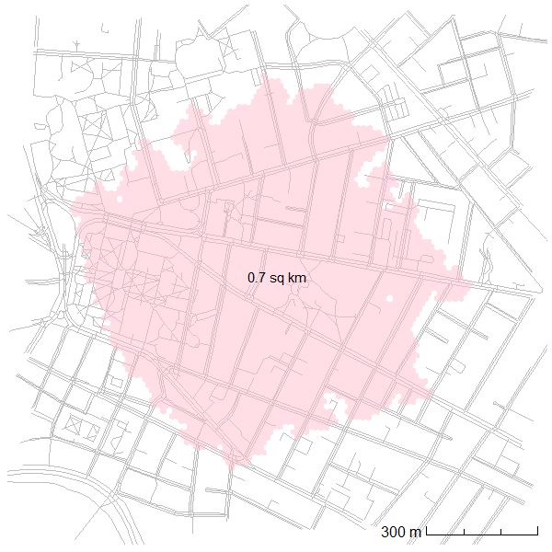
Measuring accessibility
accessibility = proximity x mobility
The size of an isochrone
The density of destinations within the isochrone
The number of destinations within the isochrone
(refer to handout for more detailed discussion of accessibility measurement)
A ten-minute pedestrian isochrone for Cambridge Rindge and Latin School

Slide 2
Types of accessibility
accessibility = proximity x mobility
The size of an isochrone
When, for whom, and by what mode?
Pedestrians
The density of destinations within the isochrone
Transit commuters during peak hours
Delivery vehicles at night
The number of destinations within the isochrone
Which destinations?
Retail and restaurants
Jobs
(refer to handout for more detailed discussion of accessibility measurement)
Customers

Slide 3
Accessibility and value
(what you might determine from looking at a map)
Value of (demand for) location (accessibility)
Value of (demand for) internal site characteristics
Property value
For discussion:
What characteristics of a site influence its value?
(what you might determine from looking at a site plan)

Slide 4
Boston Landing Case Study

Slide 5
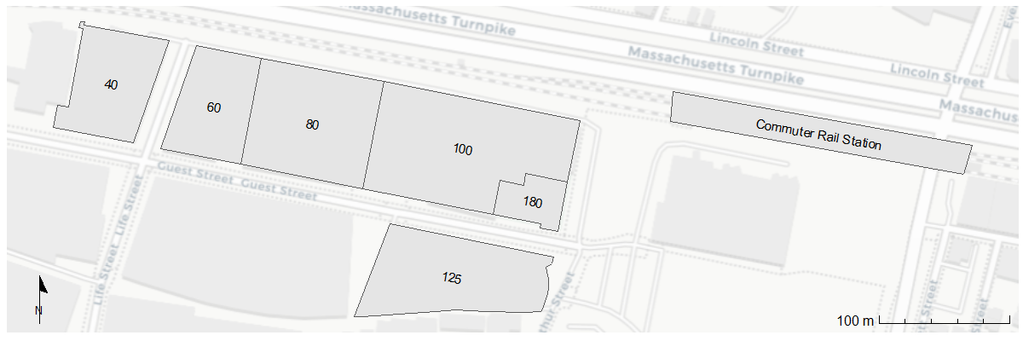
Site description
Boston Celtics Practice Facility and Lab Space (opened 2017)
Warrior Ice Arena and Office/Lab building (opened 2016)
Future office/lab building
New Balance Headquarters (opened 2013)
Lantera Residential (opened 2018)
Future hotel
In 2012, there were 1,595 jobs at this location, and 9 employed individuals lived there.
In 2020, there were 2,620 jobs at this location, and 214 employed individuals lived there.

Slide 6
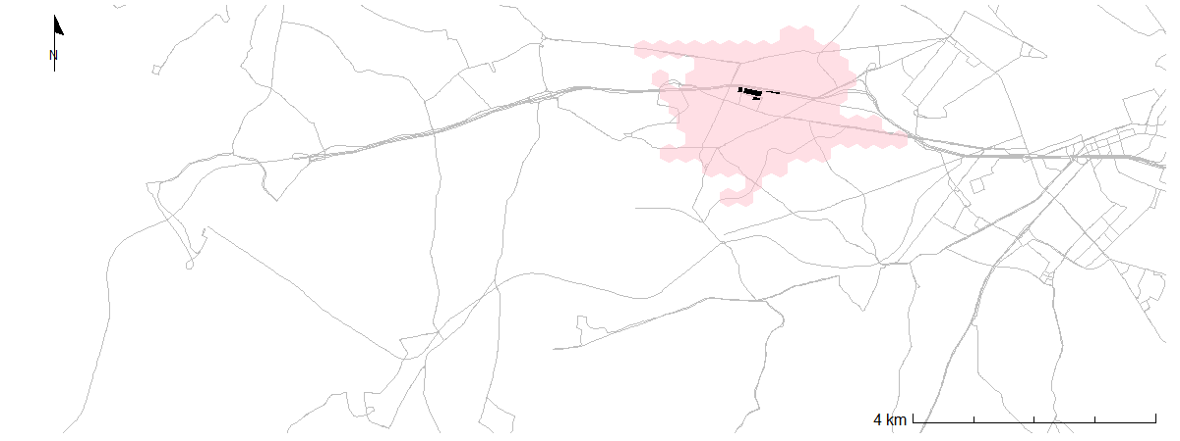
Enlarging the isochrone
Before commuter rail station
(travel from site at 6pm on a weekday)
In 2012, there were 30,561 jobs in the shaded region, and 24,414 employed individuals lived there.
In 2020, there were 47,730 jobs at the shaded region, and 27,456 employed individuals lived there.

Slide 7
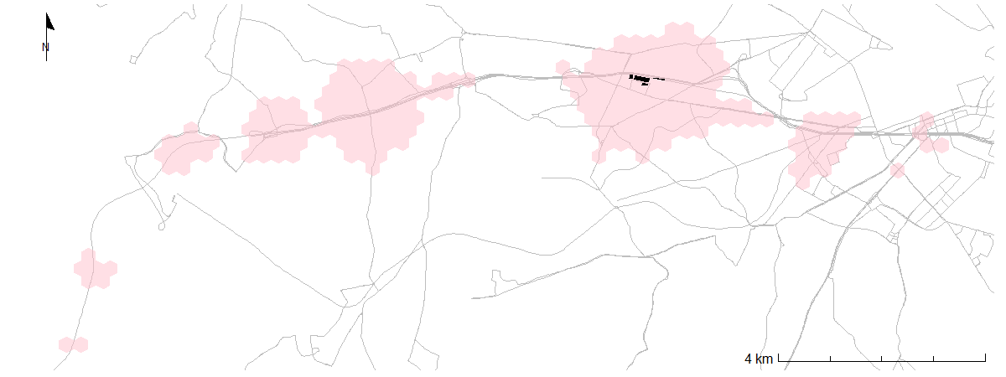
Enlarging the isochrone
After commuter rail station
(travel from site at 6pm on a weekday)
In 2012, there were 127,250 jobs in the shaded region, and 44,020 employed individuals lived there.
In 2020, there were 150,533 jobs at the shaded region, and 47,610 employed individuals lived there.

Slide 8
Discussion in pairs/groups
Discuss the questions at the end of the handout
The first four questions are for calculation
The last two questions are for speculation/informed opinion
Additional (informed opinion) questions to discuss:
What type of accessibility is most important for this particular site?
What other data would you want to have in order to answer the question of how critical the commuter rail station is to the success of this project?
How would you evaluate the success of this project?

Slide 9
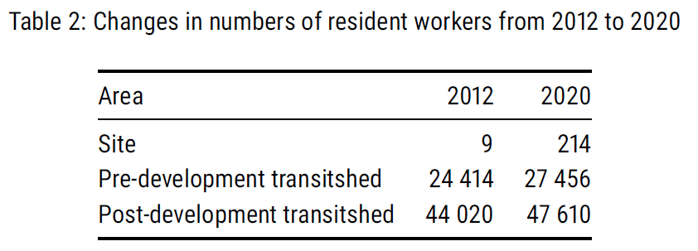

1. Increase in access to workers
$$47 610 −24 414=23 196 workers$$
$$\frac{23 196}{24 414}=95\% increase$$

Slide 10





2. Sources of increase
Increase from on-site development:
$$214−9=205 workers$$
$$\frac{205}{23 196}=1\% of total$$
Increase from off-site development:
$$47 610−44 020=3 590 workers$$
$$47 610 −24 414=23 196 workers$$
$$3 590−205=3 385 workers$$
$$\frac{3 385}{23 196}=15\% of total$$
$$\frac{23 196}{24 414}=95\% increase$$
Increase from transitshed expansion:
$$23 196−3 590=19 606 workers$$
$$\frac{19 606}{23 196}=84\% of total$$

Slide 11
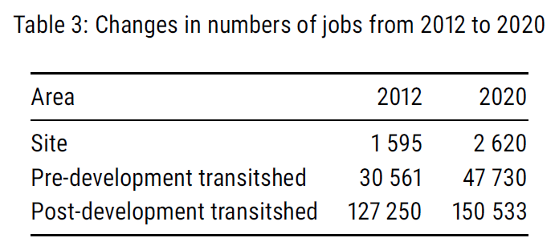


3. Increase in access to jobs
$$150 533−30 561=119 972 jobs$$
$$\frac{119 972}{30 561}=393\% increase$$

Slide 12







4. Sources of increase
Increase from on-site development:
$$2 620−1 595=1 025 jobs$$
$$\frac{1 025}{119 972}=1\% of total$$
Increase from off-site development:
$$150 533−127 250=23 283 jobs$$
$$150 533−30 561=119 972 jobs$$
$$23 283−1 025=22 258 jobs$$
$$\frac{22 258}{119 972}=19\% of total$$
$$\frac{119 972}{30 561}=393\% increase$$
Increase from transitshed expansion:
$$119 972−23 283=96 689 jobs$$
$$\frac{96 689}{119 972}=80\% of total$$

Slide 13
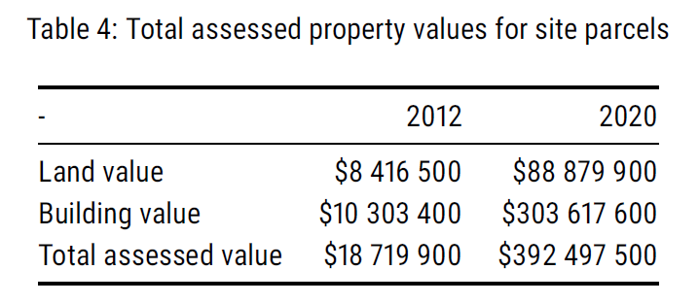
5. Value of accessibility
How much of the increase in total value can be attributed to accessibility improvements?
One possible answer: All the increase in land value (talking about accessibility broadly, not just transit access to workers and jobs).
$80 463 400 increase in land value
$373 777 600 increase in total value
About 22% of the increase is in land value, and I’m arguing that that increase is from accessibility (but not just from the rail station).

Slide 14
5. Value of accessibility II
What else besides accessibility drives land value?

Slide 15
Additional discussion
What type of accessibility is most important for this particular site?
What other data would you want to have in order to answer the question of how critical the commuter rail station is to the success of this project?
How would you evaluate the success of this project?

